Slide 1
Gaussian Elimination
Mafs, yes mafs

Slide 2
Davis Maulana Hermanto (06) Dicha Zelianivan Arkana (08) Muhammad Baihaqi Aulia Asy'ari (18) Nggih (28)
Niki Kawula Samripun

Slide 3
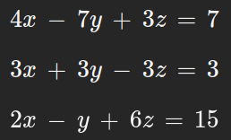

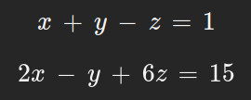

Here's the equation
Elimination
Here's how to do it
Change the 2nd equation to "x + y – z = 1"
Eliminate the 1st and 2nd equation, by multiply the 2nd equation by 7
11x – 4z = 14
Eliminate the 2nd and 3rd equation
3x + 5z = 16
Eliminate the 2 equation, by changing the coefficient to the same
We get the 67z = 134, or z = 2

Slide 4
Here's the equation
Elimination
After that, we just substitute to the other equation to find the other variables
3x + 5z = 16
3x + 5(2) = 16
3x + 10 = 16
3x = 16-10
3x = 6
x = 2
x + y – z = 1
2 + y – 2 = 1
y = 1
Then we found all the x, y, z = (2, 1, 2)

